Slide 1
Clustering

Slide 2
Outline
Introduction
K-means clustering
Hierarchical clustering: COBWEB

Slide 3
Classification vs. Clustering
Classification: Supervised learning:
Learns a method for predicting the instance class from pre-labeled (classified) instances

Slide 4
Clustering
Unsupervised learning:
Finds “natural” grouping of instances given un-labeled data

Slide 5
Clustering Methods
Many different method and algorithms:
  For numeric and/or symbolic data
  Deterministic vs. probabilistic
  Exclusive vs. overlapping
  Hierarchical vs. flat
  Top-down vs. bottom-up

Slide 6
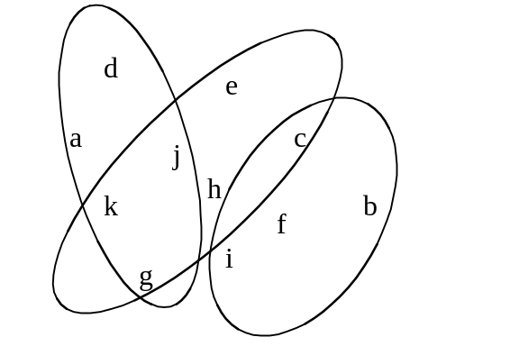
Clusters: exclusive vs. overlapping
Simple 2-D representation
Non-overlapping
Venn diagram
Overlapping
d
e
a
j
c
k
h
b
f
g
i

Slide 7
Clustering Evaluation
Manual inspection
Benchmarking on existing labels
Cluster quality measures
  distance measures
  high similarity within a cluster, low across clusters

Slide 8
The distance function
Simplest case: one numeric attribute A
  Distance(X,Y) = A(X) – A(Y)
Several numeric attributes:
  Distance(X,Y) = Euclidean distance between X,Y
Nominal attributes: distance is set to 1 if values are different, 0 if they are equal
Are all attributes equally important?
  Weighting the attributes might be necessary

Slide 9
Simple Clustering: K-means
Works with numeric data only
Pick a number (K) of cluster centers (at random)
Assign every item to its nearest cluster center (e.g. using Euclidean distance)
Move each cluster center to the mean of its assigned items
Repeat steps 2,3 until convergence (change in cluster assignments less than a threshold)

Slide 10
K-means example, step 1
k₁
Y
Pick 3
initial
cluster
centers
(randomly)
k₂
k₃
X

Slide 11
K-means example, step 2
k₁
Y
k₂
Assign
each point
to the closest
cluster
center
k₃
X

Slide 12
K-means example, step 3
k₁
k₁
Y
Move
each cluster center
to the mean
of each cluster
k₂
k₃
k₂
k₃
X

Slide 13
K-means example, step 4
Reassign
points
closest to a different new cluster center
Q: Which points are reassigned?
k₁
Y
k₃
k₂
X

Slide 14
K-means example, step 4 …
k₁
Y
A: three points with animation
k₃
k₂
X

Slide 15
K-means example, step 4b
k₁
Y
re-compute cluster means
k₃
k₂
X

Slide 16
K-means example, step 5
k₁
Y
k₂
move cluster centers to cluster means
k₃
X

Slide 17
Discussion
Result can vary significantly depending on initial choice of seeds
Can get trapped in local minimum
  Example:
To increase chance of finding global optimum: restart with different random seeds
initial cluster centers
instances

Slide 18
K-means clustering summary
Advantages
Simple, understandable
items automatically assigned to clusters
Disadvantages
Must pick number of clusters before hand
All items forced into a cluster
Too sensitive to outliers

Slide 19
K-means variations
K-medoids – instead of mean, use medians of each cluster
  Mean of 1, 3, 5, 7, 9 is
  Mean of 1, 3, 5, 7, 1009 is
  Median of 1, 3, 5, 7, 1009 is
  Median advantage: not affected by extreme values
For large databases, use sampling
5
205
5

Slide 20
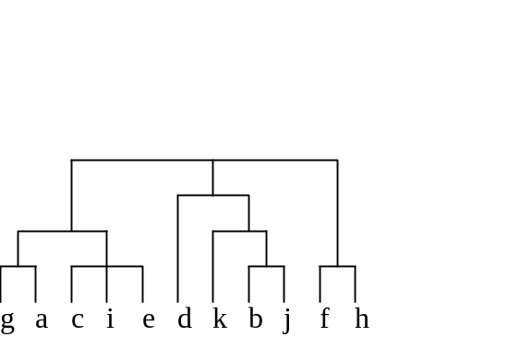
*Hierarchical clustering
Bottom up
  Start with single-instance clusters
  At each step, join the two closest clusters
  Design decision: distance between clusters
    E.g. two closest instances in clusters
    vs. distance between means
Top down
  Start with one universal cluster
  Find two clusters
  Proceed recursively on each subset
  Can be very fast
Both methods produce a
dendrogram

Slide 21
*Incremental clustering
Heuristic approach (COBWEB/CLASSIT)
Form a hierarchy of clusters incrementally
Start:
  tree consists of empty root node
Then:
  add instances one by one
  update tree appropriately at each stage
  to update, find the right leaf for an instance
  May involve restructuring the tree
Base update decisions on category utility

Slide 22
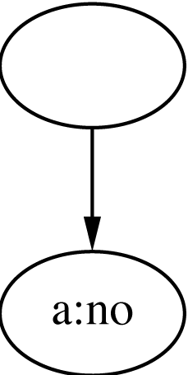
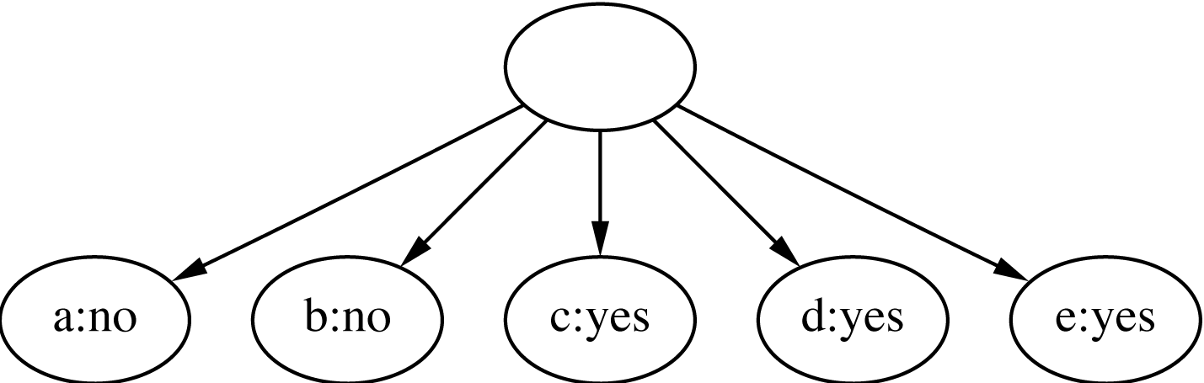
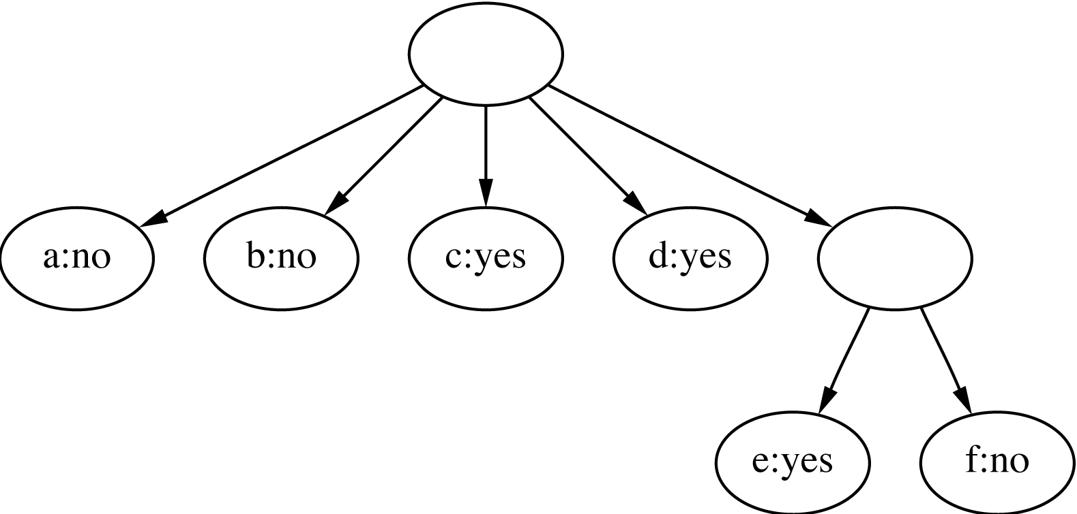
*Clustering weather data
1
ID | Outlook | Temp. | Humidity | Windy
A | Sunny | Hot | High | False
B | Sunny | Hot | High | True
C | Overcast | Hot | High | False
D | Rainy | Mild | High | False
E | Rainy | Cool | Normal | False
F | Rainy | Cool | Normal | True
G | Overcast | Cool | Normal | True
H | Sunny | Mild | High | False
I | Sunny | Cool | Normal | False
J | Rainy | Mild | Normal | False
K | Sunny | Mild | Normal | True
L | Overcast | Mild | High | True
M | Overcast | Hot | Normal | False
N | Rainy | Mild | High | True
2
3

Slide 23
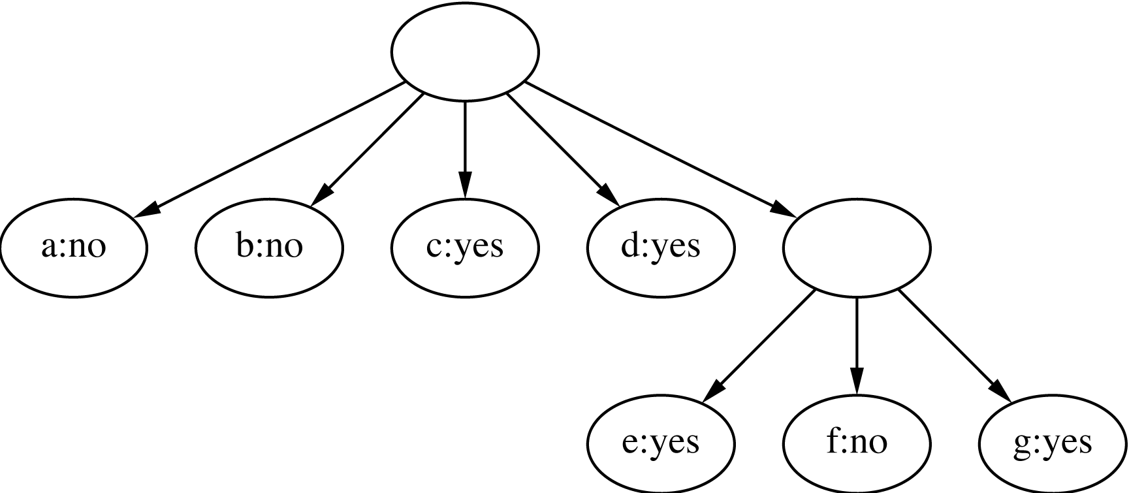
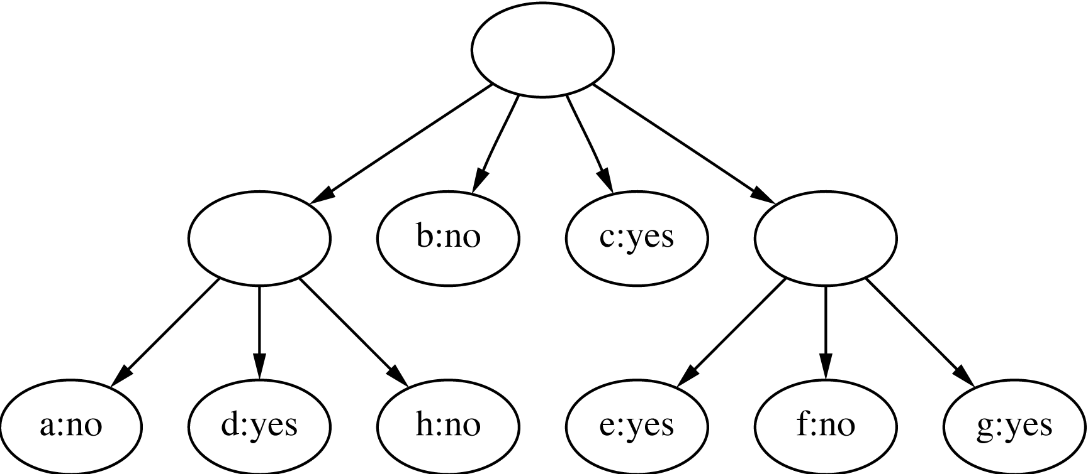
*Clustering weather data
4
ID | Outlook | Temp. | Humidity | Windy
A | Sunny | Hot | High | False
B | Sunny | Hot | High | True
C | Overcast | Hot | High | False
D | Rainy | Mild | High | False
E | Rainy | Cool | Normal | False
F | Rainy | Cool | Normal | True
G | Overcast | Cool | Normal | True
H | Sunny | Mild | High | False
I | Sunny | Cool | Normal | False
J | Rainy | Mild | Normal | False
K | Sunny | Mild | Normal | True
L | Overcast | Mild | High | True
M | Overcast | Hot | Normal | False
N | Rainy | Mild | High | True
5
Merge best host and runner-up
3
Consider splitting the best host if merging doesn’t help

Slide 24
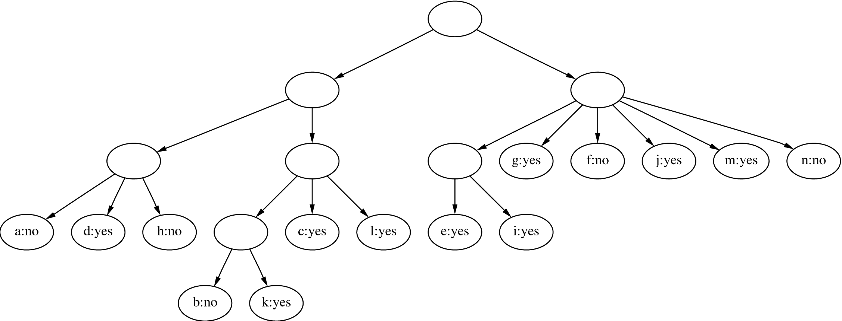
*Final hierarchy
ID | Outlook | Temp. | Humidity | Windy
A | Sunny | Hot | High | False
B | Sunny | Hot | High | True
C | Overcast | Hot | High | False
D | Rainy | Mild | High | False
Oops! a and b are actually very similar

Slide 25
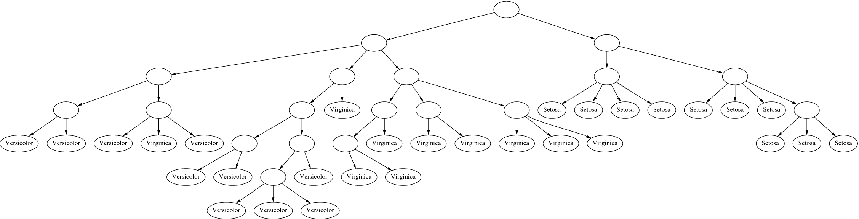
*Example: the iris data (subset)

Slide 26
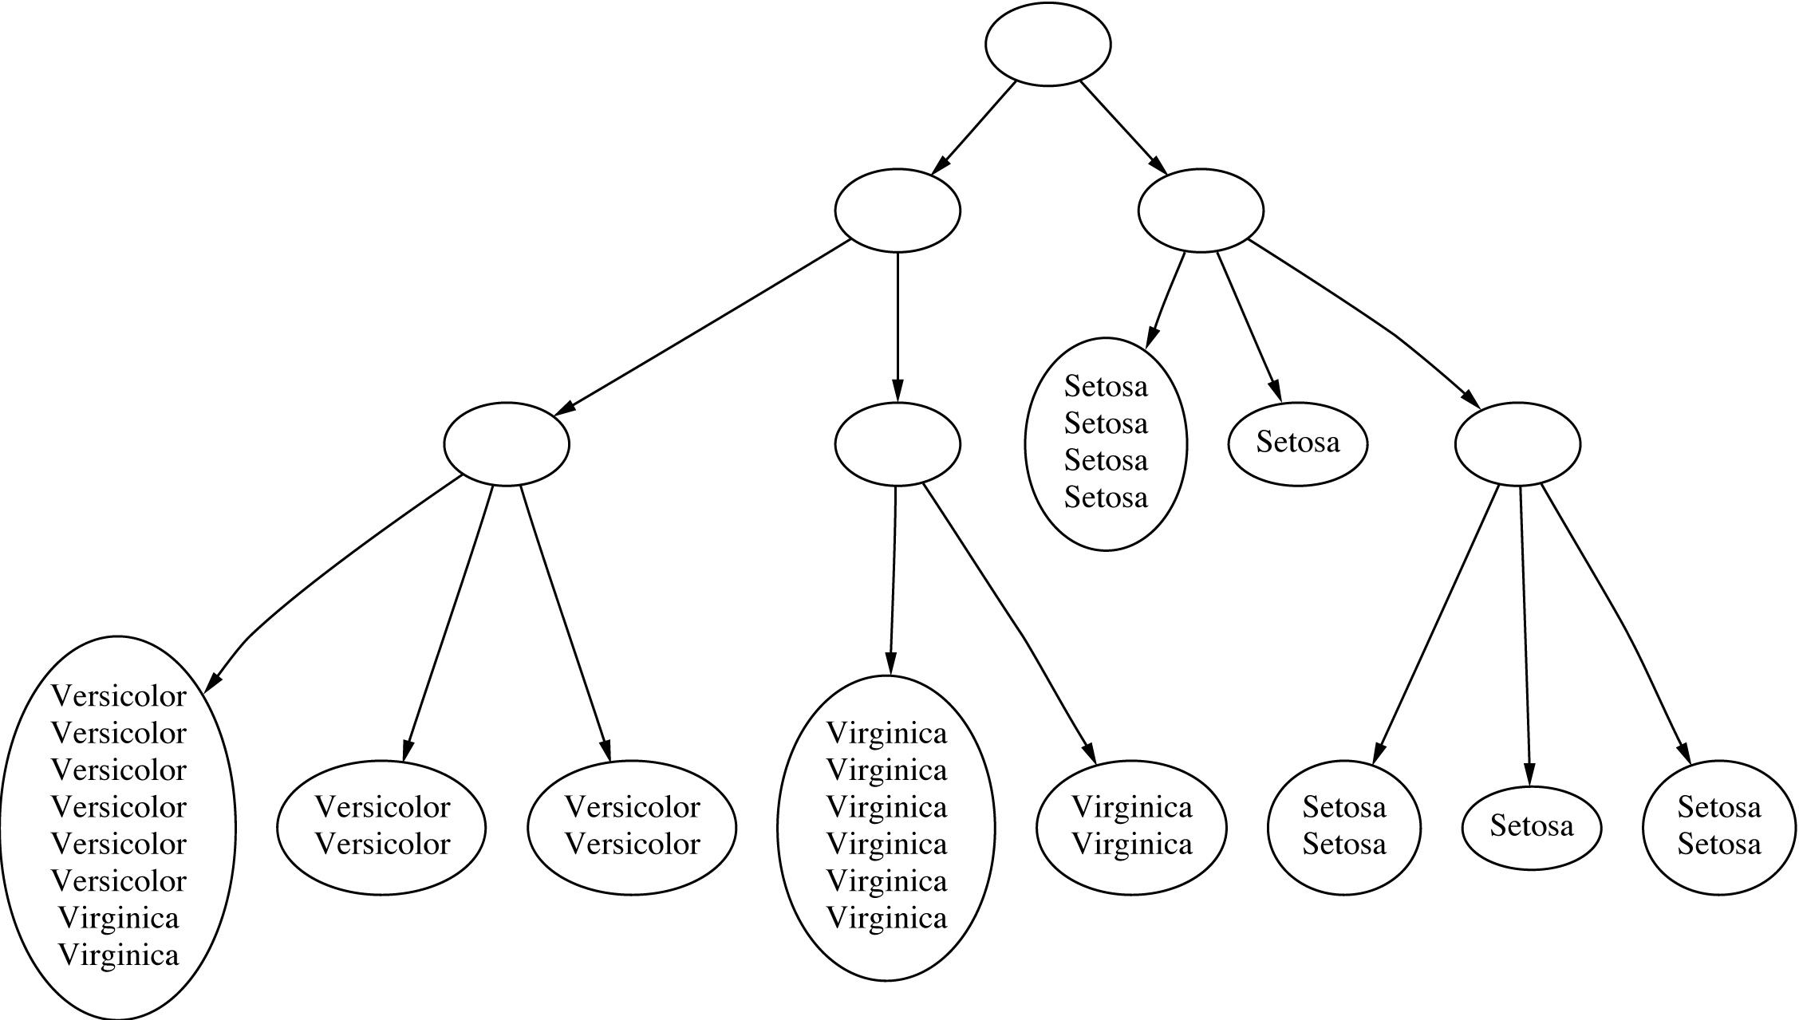
*Clustering with cutoff

Slide 27
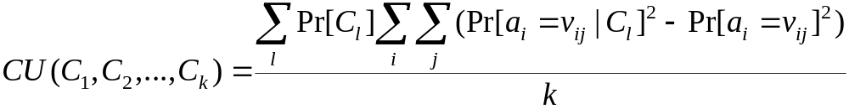

*Category utility
Category utility: quadratic loss function
defined on conditional probabilities:
Every instance in different category ⇒
numerator becomes
maximum
number of attributes

Slide 28
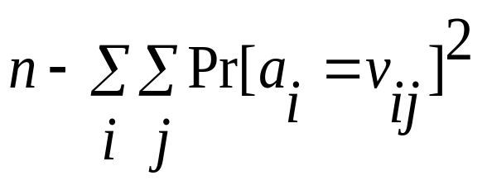
*Overfitting-avoidance heuristic
If every instance gets put into a different category the numerator becomes (maximal):
Where n is number of all possible attribute values.
So without k in the denominator of the CU-formula, every cluster would consist of one instance!
Maximum value of CU

Slide 29
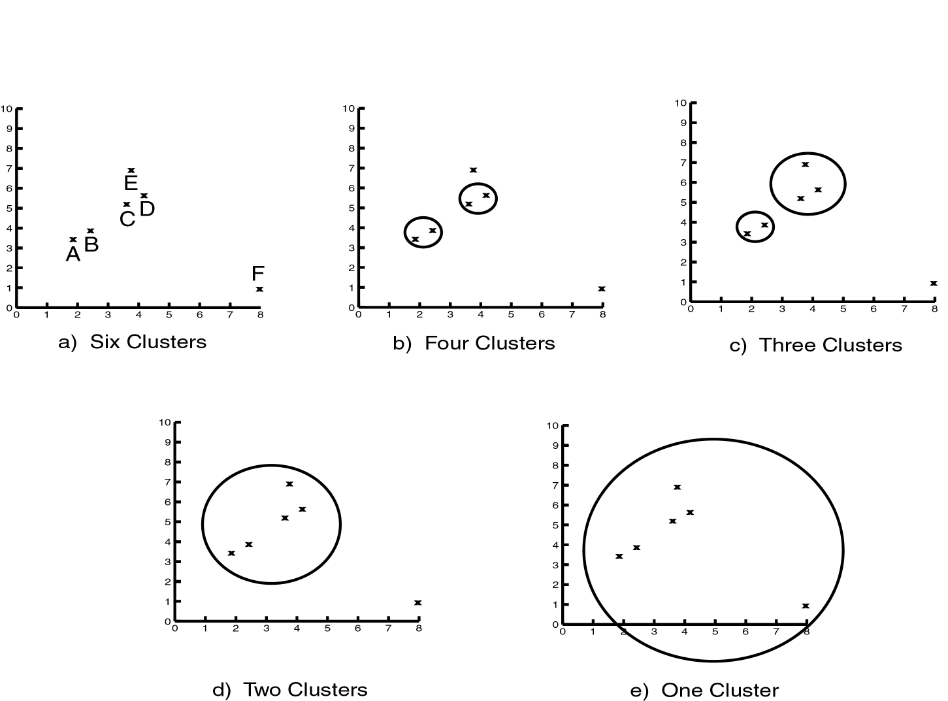
Levels of Clustering

Slide 30
Hierarchical Clustering
Clusters are created in levels actually creating sets of clusters at each level.
Agglomerative
  Initially each item in its own cluster
  Iteratively clusters are merged together
  Bottom Up
Divisive
  Initially all items in one cluster
  Large clusters are successively divided
  Top Down

Slide 31
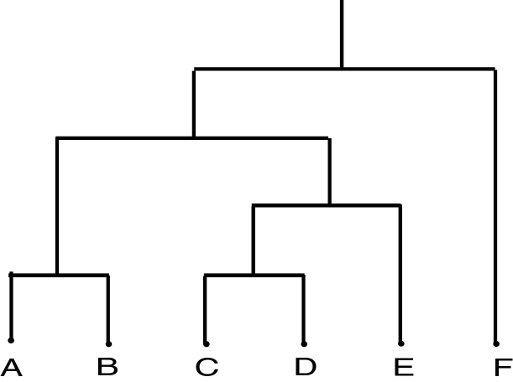
Dendrogram
Dendrogram: a tree data structure which illustrates hierarchical clustering techniques.
Each level shows clusters for that level.
  Leaf – individual clusters
  Root – one cluster
A cluster at level i is the union of its children clusters at level i+1.

Slide 32
Agglomerative Example
 | A | B | C | D | E
A | 0 | 1 | 2 | 2 | 3
B | 1 | 0 | 2 | 4 | 3
C | 2 | 2 | 0 | 1 | 5
D | 2 | 4 | 1 | 0 | 3
E | 3 | 3 | 5 | 3 | 0
A
B
E
C
D
Threshold of
1
2
3
4
5
A
B
C
D
E

Slide 33
Distance Between Clusters
Single Link: smallest distance between points
Complete Link: largest distance between points
Average Link: average distance between points
Centroid: distance between centroids

Slide 34
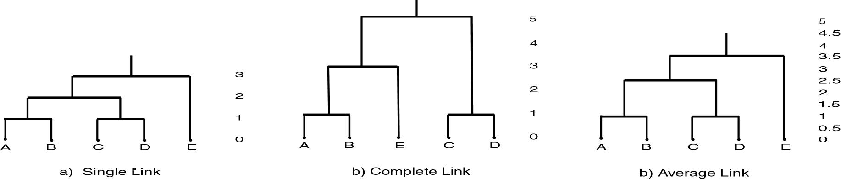
Single Link Clustering

Slide 35
Other Clustering Approaches
EM – probability based clustering
Bayesian clustering
SOM – self-organizing maps
…

Slide 36
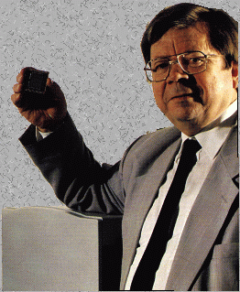
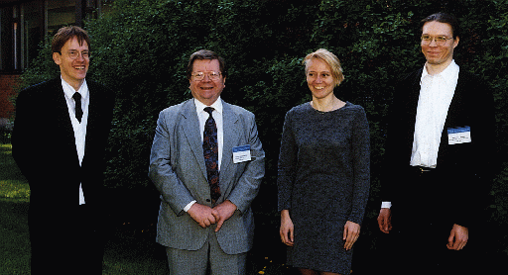
Self-Organizing Map

Slide 37
Self Organizing Map
Unsupervised learning
Competitive learning
winner
output
input (n-dimensional)

Slide 38
Self Organizing Map
Determine the winner (the neuron of which the weight vector has the smallest distance to the input vector)
Move the weight vector w of the winning neuron towards the input i
i
i
w
w
Before learning
After learning

Slide 39
Self Organizing Map
Impose a topological order onto the competitive neurons (e.g., rectangular map)
Let neighbors of the winner share the “prize” (The “postcode lottery” principle)
After learning, neurons with similar weights tend to cluster on the map

Slide 40
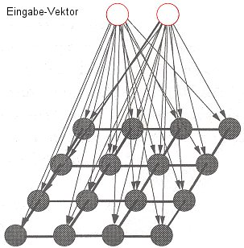
Self Organizing Map
input

Slide 41
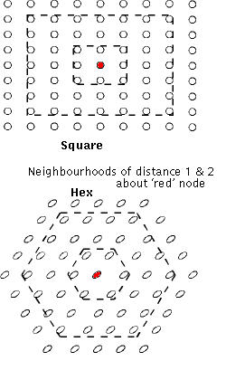
Self Organizing Map

Slide 42
Self Organizing Map
Input: uniformly randomly distributed points
Output: Map of 20² neurons
Training
  Starting with a large learning rate and neighborhood size, both are gradually decreased to facilitate convergence

Slide 43
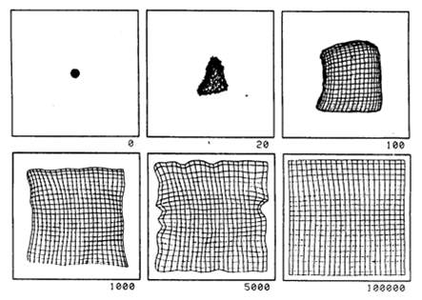
Self Organizing Map

Slide 44
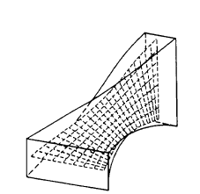
Self Organizing Map

Slide 45
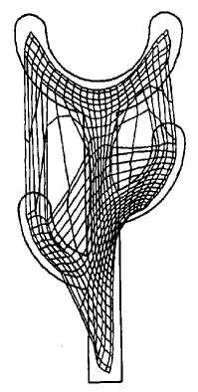
Self Organizing Map

Slide 46
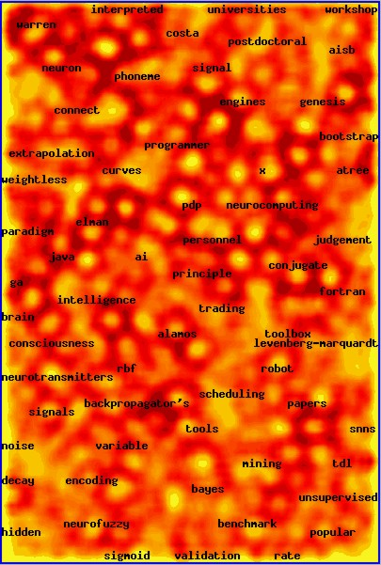

Slide 47
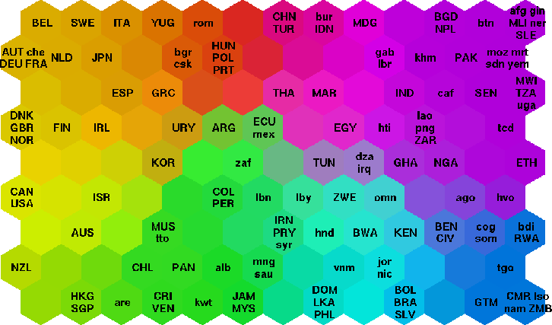
Self Organizing Map

Slide 48
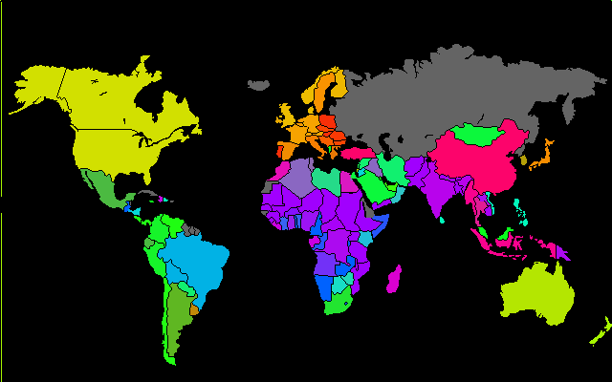
Self Organizing Map

Slide 49
Discussion
Can interpret clusters by using supervised learning
  learn a classifier based on clusters
Decrease dependence between attributes?
  pre-processing step
  E.g. use principal component analysis
Can be used to fill in missing values
Key advantage of probabilistic clustering:
  Can estimate likelihood of data
  Use it to compare different models objectively

Slide 50
Examples of Clustering Applications
Marketing: discover customer groups and use them for targeted marketing and re-organization
Astronomy: find groups of similar stars and galaxies
Earth-quake studies: Observed earth quake epicenters should be clustered along continent faults
Genomics: finding groups of gene with similar expressions
…

Slide 51
Clustering Summary
unsupervised
many approaches
  K-means – simple, sometimes useful
    K-medoids is less sensitive to outliers
  Hierarchical clustering – works for symbolic attributes
Evaluation is a problem

